Slide 1
Recurrent Neural Networks (II)

Slide 2
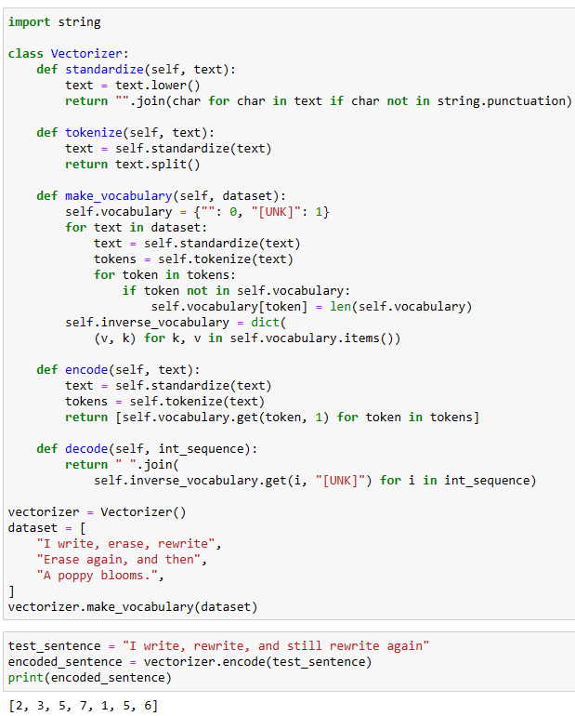
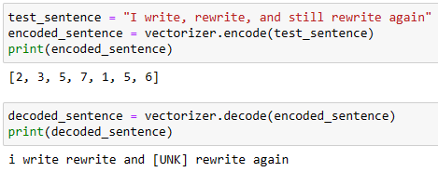
Text Processing
Text Vectorization

Slide 3
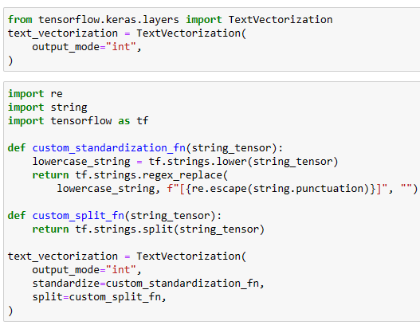
TextVectorization Layer
A preprocessing layer which maps text features to integer sequences.
max_tokens: Maximum size of the vocabulary for this layer.
output_mode: Optional specification for the output of the layer. Values can be "int", "multi_hot", "count" or "tf_idf"
output_sequence_length: Only valid in INT mode. If set, the output will have its time dimension padded or truncated to exactly output_sequence_length values
standardize: Optional specification for standardization to apply to the input text.
split: Optional specification for splitting the input text.
https://keras.io/api/layers/preprocessing_layers/text/text_vectorization/#textvectorization-class

Slide 4
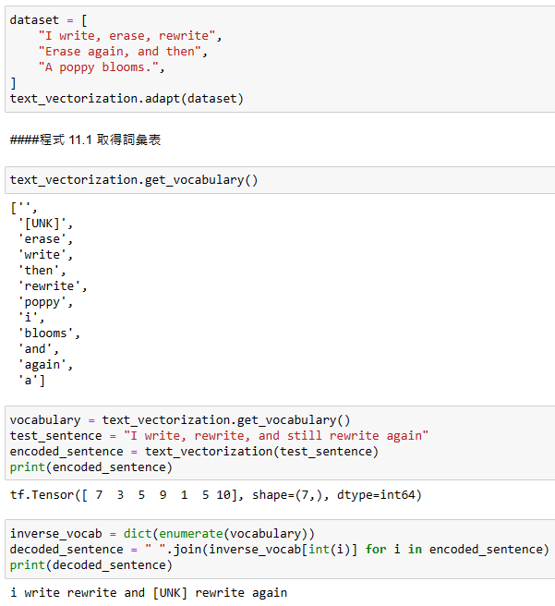
The vocabulary for the TextVectorization layer must be either supplied on construction or learned via adapt(). When this layer is adapted, it will analyze the dataset, determine the frequency of individual string values, and create a vocabulary from them.

Slide 5
IMDB Data Set
IMDB movie review
  Positive or negative
  25000 training
    0 ~12499: positive, 12500 ~ 24999: negative
  25000 testing
    0 ~12499: positive, 12500 ~ 24999: negative

Slide 6
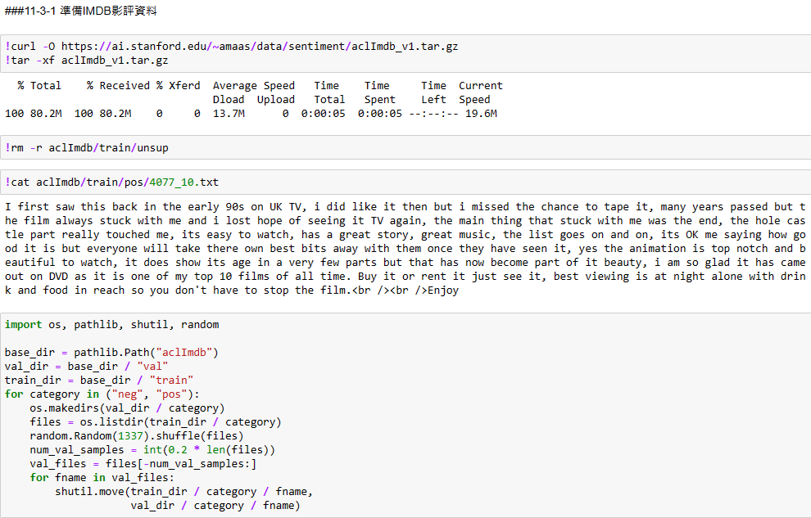

Slide 7
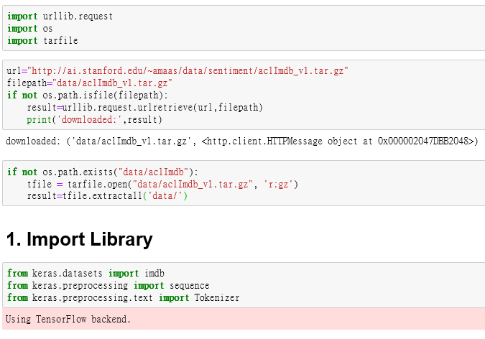
Download data
Extract compressed file

Slide 8
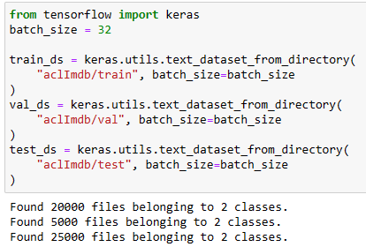
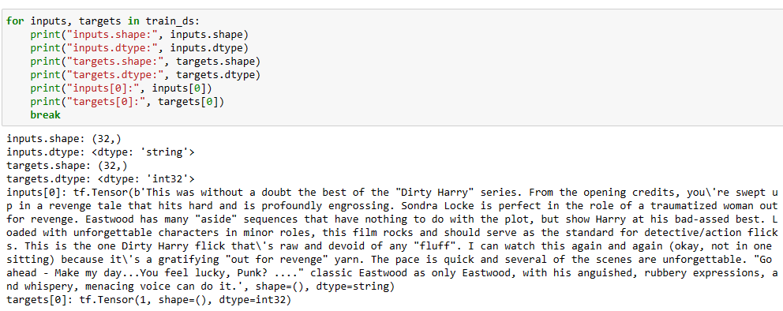
text_dataset_from_directory(): Generates a tf.data.Dataset from text files in a directory.
https://keras.io/api/preprocessing/text/

Slide 9
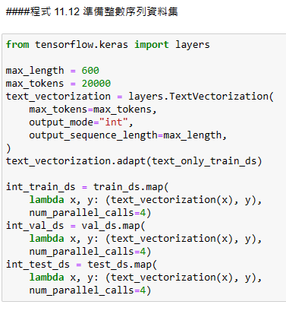
TextVectorization: A preprocessing layer which maps text features to integer sequences.
The vocabulary for the layer must be either supplied on construction or learned via adapt(). The most frequent terms will be used to create the vocabulary.
Standardize each example (usually lowercasing + punctuation stripping)
The processing of each example contains the following steps:
Split each example into substrings (usually words)
Recombine substrings into tokens (usually ngrams)
Index tokens (associate a unique int value with each token)
Transform each example using this index, either into a vector of ints or a dense float vector.
https://keras.io/api/layers/preprocessing_layers/text/text_vectorization/#textvectorization-class

Slide 10
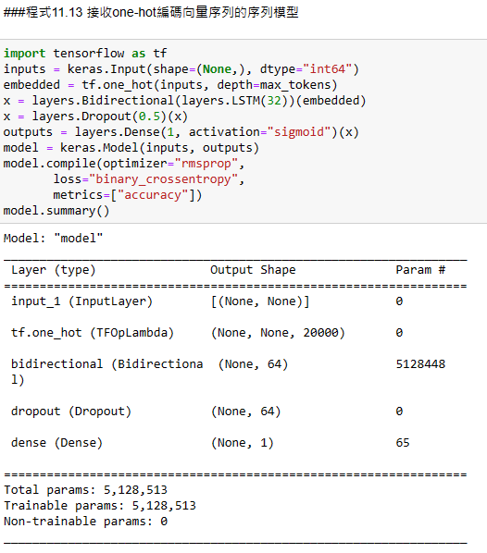
https://www.tensorflow.org/api_docs/python/tf/one_hot
One-hot encoding data
>>> layer = tf.keras.layers.CategoryEncoding(
... num_tokens=4, output_mode="one_hot")
>>> layer([3, 2, 0, 1])
<tf.Tensor: shape=(4, 4), dtype=float32, numpy=
array([[0., 0., 0., 1.],
[0., 0., 1., 0.],
[1., 0., 0., 0.],
[0., 1., 0., 0.]], dtype=float32)>
Multi-hot encoding data
>>> layer = tf.keras.layers.CategoryEncoding(
... num_tokens=4, output_mode="multi_hot")
>>> layer([[0, 1], [0, 0], [1, 2], [3, 1]])
<tf.Tensor: shape=(4, 4), dtype=float32, numpy=
array([[1., 1., 0., 0.],
[1., 0., 0., 0.],
[0., 1., 1., 0.],
[0., 1., 0., 1.]], dtype=float32)>
https://keras.io/api/layers/preprocessing_layers/categorical/category_encoding/

Slide 11
keras.layers.LSTM(units, activation='tanh', recurrent_activation='sigmoid', use_bias=True, kernel_initializer='glorot_uniform', recurrent_initializer='orthogonal', bias_initializer='zeros', unit_forget_bias=True, kernel_regularizer=None, recurrent_regularizer=None, bias_regularizer=None, activity_regularizer=None, kernel_constraint=None, recurrent_constraint=None, bias_constraint=None, dropout=0.0, recurrent_dropout=0.0, implementation=2, return_sequences=False, return_state=False, go_backwards=False, stateful=False, unroll=False)
Long Short-Term Memory layer - Hochreiter 1997.
  recurrent_activation: Activation function to use for the recurrent step. Default: hard sigmoid (hard_sigmoid). If you pass None, no activation is applied (ie. "linear" activation: a(x) = x).
  unit_forget_bias: Boolean. If True, add 1 to the bias of the forget gate at initialization. Setting it to true will also force bias_initializer="zeros". This is recommended in Jozefowicz et al. (2015).
  implementation: Implementation mode, either 1 or 2. Mode 1 will structure its operations as a larger number of smaller dot products and additions, whereas mode 2 will batch them into fewer, larger operations. These modes will have different performance profiles on different hardware and for different applications.

Slide 12
keras.layers.SimpleRNN(units, activation='tanh', use_bias=True, kernel_initializer='glorot_uniform', recurrent_initializer='orthogonal', bias_initializer='zeros', kernel_regularizer=None, recurrent_regularizer=None, bias_regularizer=None, activity_regularizer=None, kernel_constraint=None, recurrent_constraint=None, bias_constraint=None, dropout=0.0, recurrent_dropout=0.0, return_sequences=False, return_state=False, go_backwards=False, stateful=False, unroll=False)
Fully-connected RNN where the output is to be fed back to input.
  units: Positive integer, dimensionality of the output space.
  activation: Activation function to use. Default: hyperbolic tangent (tanh). If you pass None, no activation is applied (ie. "linear" activation: a(x) = x).
  use_bias: Boolean, whether the layer uses a bias vector.
  dropout: Float between 0 and 1. Fraction of the units to drop for the linear transformation of the inputs.
  recurrent_dropout: Float between 0 and 1. Fraction of the units to drop for the linear transformation of the recurrent state.
  return_sequences: Boolean. Whether to return the last output in the output sequence, or the full sequence.
  return_state: Boolean. Whether to return the last state in addition to the output.
  go_backwards: Boolean (default False). If True, process the input sequence backwards and return the reversed sequence.
  stateful: Boolean (default False). If True, the last state for each sample at index i in a batch will be used as initial state for the sample of index i in the following batch.
  unroll: Boolean (default False). If True, the network will be unrolled, else a symbolic loop will be used. Unrolling can speed-up a RNN, although it tends to be more memory-intensive. Unrolling is only suitable for short sequences.

Slide 13
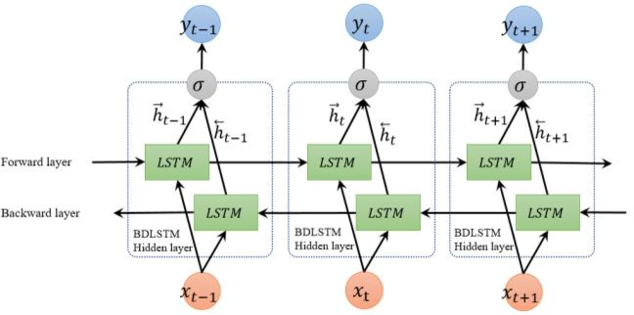
Bidirectional LSTM (biLSTM)
Bidirectional()
layer: Recurrent instance.
merge_mode: Mode by which outputs of the forward and backward RNNs will be combined. One of {'sum', 'mul', 'concat', 'ave', None}. If None, the outputs will not be combined, they will be returned as a list.
weights: Initial weights to load in the Bidirectional model
https://keras.io/api/layers/recurrent_layers/bidirectional/

Slide 14
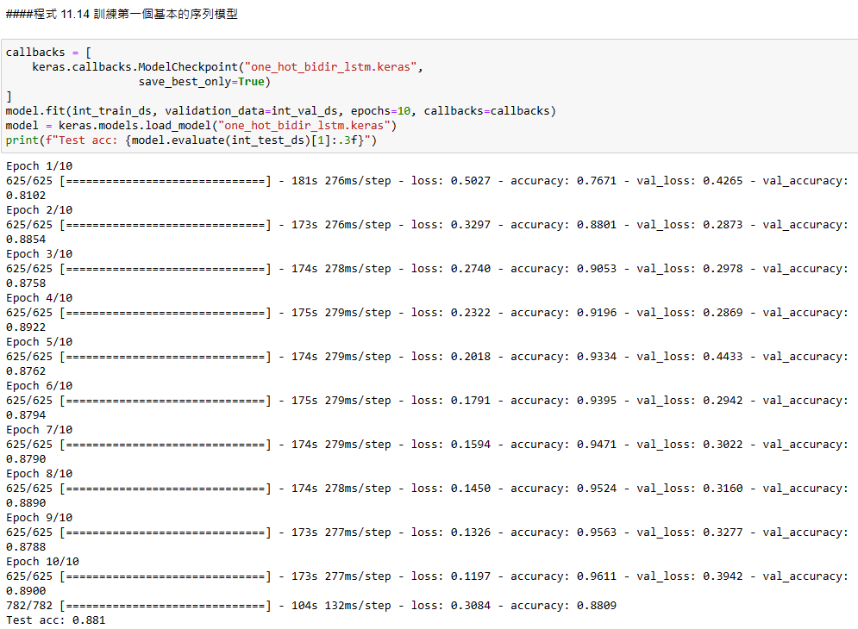

Slide 15
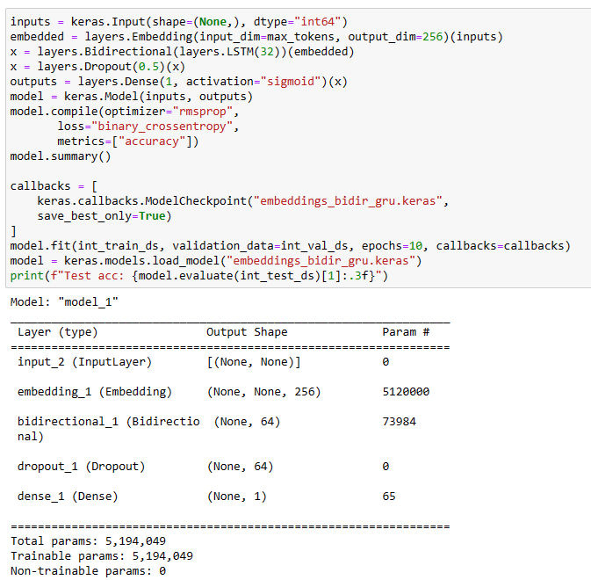
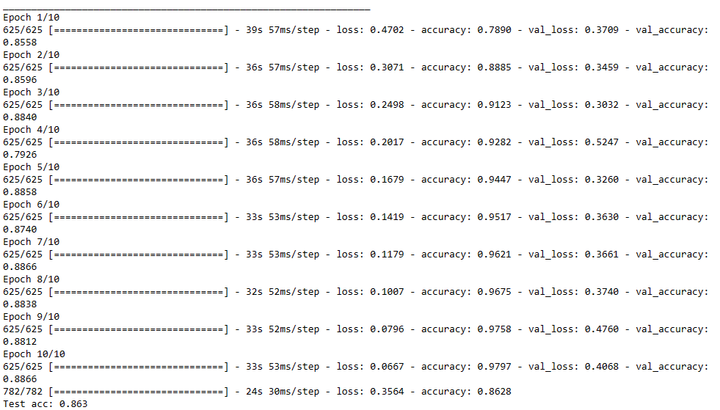

Slide 16
Embedding layer
  Turns positive integers (indexes) into dense vectors of fixed size.
  Word embeddings give us a way to use an efficient, dense representation in which similar words have a similar encoding.
  Word embedding vectors are learned as the model trains.
input_dim: int > 0. Size of the vocabulary, i.e. maximum integer index + 1.
output_dim: int >= 0. Dimension of the dense embedding.
mask_zero: Whether or not the input value 0 is a special "padding" value that should be masked out. This is useful when using recurrent layers which may take variable length input. If this is True then all subsequent layers in the model need to support masking or an exception will be raised. If mask_zero is set to True, as a consequence, index 0 cannot be used in the vocabulary (input_dim should equal size of vocabulary + 1).
input_length: Length of input sequences, when it is constant. This argument is required if you are going to connect Flatten then Dense layers upstream (without it, the shape of the dense outputs cannot be computed).
https://keras.io/api/layers/core_layers/embedding/

Slide 17
